Slide 1

Coding Workshop Datatypes I
09.02.2026
Melissa Franke

Slide 2


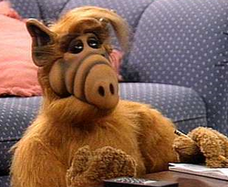

The goal of this course
Write your own python programs
Prerequisites:
Have ideas how to solve problems
Know (superficially) how the computer stores data
Know (superficially) how the computer works with data
Know how a programming language handles data
Know the programming language
✔
Coding Workshop
Datatypes I
Melissa Franke
M.Sc
0

Slide 3
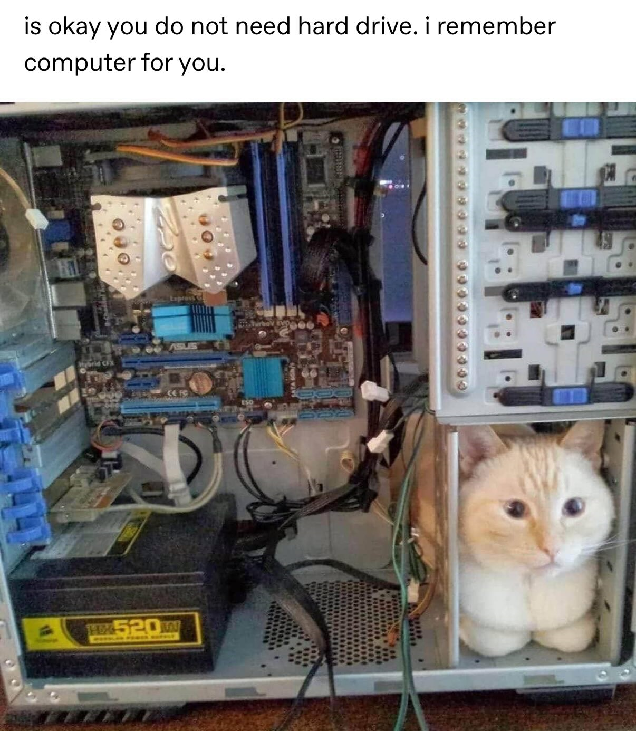
How does the computer store data?
Long term storage (optional):
Files on hard drive
Files on Storage media
Files on Servers
Working / short term storage:
Variables in RAM
What is a variable?
Unit with a name and address taking up space in RAM
Coding Workshop
Datatypes I
Melissa Franke
M.Sc
1
Notes:
Marc – 1.109 – one office
Lena – 1.110 – 1/6th of an office

Slide 4

How does the computer store data?
Decimal number uses base 10
Example: 365 -> 3*10² + 60*10¹ + 5*10⁰
Binary number uses base 2
Example: 0110 -> 0*2³ + 1*2² + 1*2¹ + 0*2¹
Everything in your Computer is stored as Binary Data
100
10
1
8
4
2
1
Coding Workshop
Datatypes I
Melissa Franke
M.Sc
2

Slide 5
The goal of this course
Write your own python programs
Prerequisites:
Have ideas how to solve problems ✔
Know (superficially) how the computer stores data ✔
Know (superficially) how the computer works with data
Know how a programming language handles data
Know the programming language
Coding Workshop
Datatypes I
Melissa Franke
M.Sc
0

Slide 6


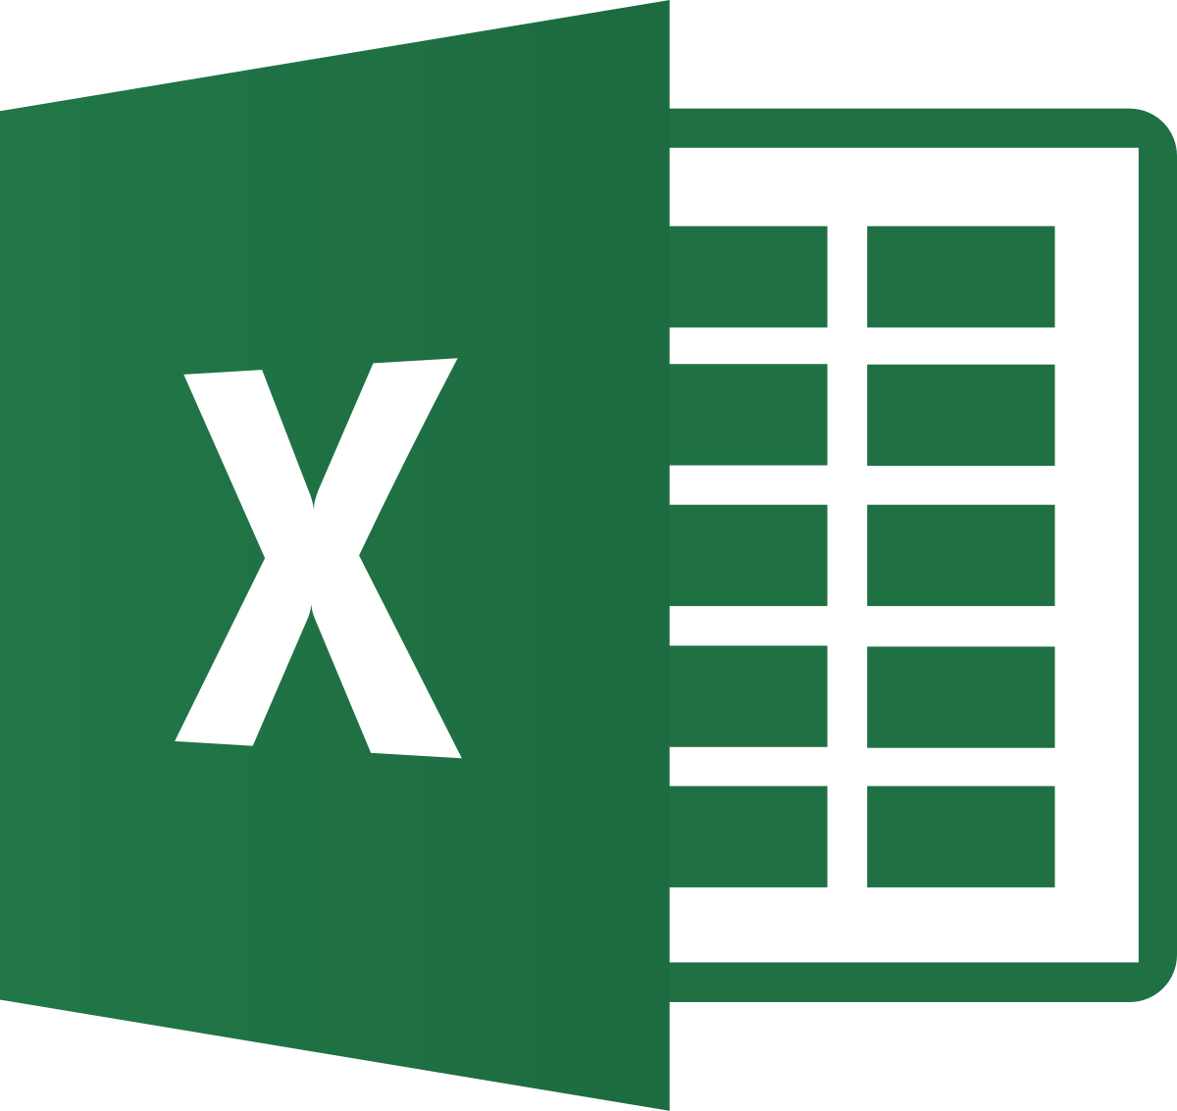
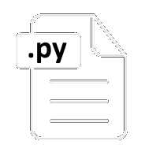
How does the computer work on data?
RAM
Mainboard
CPU
ALU
Harddrive
The Real World
Your Computer
Coding Workshop
Datatypes I
Melissa Franke
M.Sc
3

Slide 7

How does the computer work on data?
RAM
Mainboard
Operation
CPU
Calculation
Result
ALU
Harddrive
Coding Workshop
Datatypes I
Melissa Franke
M.Sc
3

Slide 8

How does the computer work on data?
RAM
Mainboard
Operation
CPU
Calculation
Result
ALU
Harddrive
Computer Ressources:
Time
RAM space
The Real World
Your Computer
Coding Workshop
Datatypes I
Melissa Franke
M.Sc
3

Slide 9
The goal of this course
Write your own python programs
Prerequisites:
Have ideas how to solve problems ✔
Know (superficially) how the computer stores data ✔
Know (superficially) how the computer works with data ✔
Know how a programming language handles data
Know the programming language
Coding Workshop
Datatypes I
Melissa Franke
M.Sc
0

Slide 10
Why is this all important?
Memory and Time are Ressources!
Every open program, running code, loaded experimental data, variable and result takes up RAM
Every line of code can be several Operations for the CPU
Operations take time
Best practices → little RAM as possible, little operations as possible
Fast programs with little loading delay
Coding Workshop
Datatypes I
Melissa Franke
M.Sc
2

Slide 11
The goal of this course
Write your own python programs
Prerequisites:
Have ideas how to solve problems ✔
Know (superficially) how the computer stores data ✔
Know (superficially) how the computer works with data ✔
Know how a programming language handles data ←
Know the programming language
Coding Workshop
Datatypes I
Melissa Franke
M.Sc
0

Slide 12
Simple Datatypes

Slide 13
Types of data - Boolean
Value of a Boolean can be True or False (1 or 0) but nothing else
Can be used to check statements:
bool(x > y) bool(x >= y)
Bool(x < y) bool(x <=y)
Bool(x == y) bool(x is y)
Bool(x != y) bool (x is not y)
Can be used to check emptiness:
bool(0)
bool(42)
bool(‘’)
bool(‘hello world’)
Coding Workshop
Datatypes I
Melissa Franke
M.Sc
4

Slide 14
Types of data - Integer
Value of an integer can be any whole number, negative or positive
Typically used to store
(Data)
Checks -> see also Lesson 04: conditions
Counters -> see also Lesson 05: loops
Iterators -> used in Lesson 05: loops
Operators:
+, -, *, /
**, %, //
Coding Workshop
Datatypes I
Melissa Franke
M.Sc
5

Slide 15
Types of data – Floating point number
Value of a float can be any real number, negative or positive
Typically used to store:
Data
Factors, other mathematical operators
Operators:
+, -, *, /
**, %, //
Warning:
Display will never be exact! Only rounded version of true machine value!
True machine value will also never be exact, only approximation, because the computer uses binary!
Coding Workshop
Datatypes I
Melissa Franke
M.Sc
6

Slide 16
Types of data - Character
Value of a character is a singular letter
Typically never used in python
Essential for old programming languages
Base unit of a String
Coding Workshop
Datatypes I
Melissa Franke
M.Sc
7

Slide 17
Types of data - String
Value of a String are strings of letters
Typically used to store:
Data
Messages
Filepaths
Operators:
Many
Coding Workshop
Datatypes I
Melissa Franke
M.Sc
8

Slide 18
Simple Datatypes - summary
Boolean : true or false, examples: True, False
Integer: whole numbers, examples: 125; -7
Float: real numbers, examples: -123.4; 0.3333333333…
Character: single letter, examples: “A”; “:”
String: string of Characters, examples: “Hello”; “This is an example”
Coding Workshop
Datatypes I
Melissa Franke
M.Sc
9

Slide 19
Nice to know: Data typing
How does a language handle datatypes?
Typing in C: int myNumber = 10
myNumber = ‘Hello World!’
-> Error: myNumber is an Integer
Typing in my_number = 10
Python: my_number = ‘Hello World’
# no error, variable is reassigned
Statically typed language
Dynamically typed language
Coding Workshop
Datatypes I
Melissa Franke
M.Sc
9

Slide 20
Questions?

Slide 21
Datatypes I - Exercises
Hints:
print(x) – displays x in terminal
type(x) – shows datatype of x
= assigns value
== shows bit-equality
is shows value equality
<, <=, >, >= math comparisons
!, not – negates
and – both terms need to be True for statement to be True
or – one or both terms need to be True for statement to be True
Exercise 1: Variables and Boolean statements
1. type the following code:
var1 = 5 var2 = 10.1 var3 = 5 var4 = False
2. Use print() and type() to find out the datatype of your variables
3. check the following statements:
var1 == var3 (var1 == var3) and not var4 var1 is var3 not var4 or (var1 != var2) var2 <= var4 (var1 == var3) or (var2==var1) var2 is not var3 not (var4 or (var1 == var2)) or (var1<var2)
Coding Workshop
Datatypes I
Melissa Franke
M.Sc
10

Slide 22
Datatypes I - Exercises
Hints:
type() and print() can be nestled
var1 = type(var)
print(var1)
print(type(var))
Exercise 2: String variables
Declare a variable of datatype String containing your name.
Declare a variable of datatype String containing the value of Pi (3.1415)
Declare a variable of datatype String containing the value 3
Declare a variable of datatype Boolean that is true
After every step, please use the function print(var) and print(type(var))
Coding Workshop
Datatypes I
Melissa Franke
M.Sc
11

Slide 23
Datatypes I - Exercises
Hints:
bool()
int()
float()
str()
To uncomment, add an # before the code
Exercise 5: typecasting
Try to typecast your name to Integer, Float and Boolean. What happens?
Uncomment what does not work (intentionally)
Try to typecast your Pi-String to Float. Afterwards typecast it to Integer. What happens?
Try to check if your new Integer is the same as your third variable typecasted to int.
After every step, please use the function type() and print()
Coding Workshop
Datatypes I
Melissa Franke
M.Sc
12

Slide 24
Datatypes I - Exercises
Hints:
bool()
int()
float()
str()
Some variables may need to be typecasted more than once
Exercise 4: advantages of typecasting
Check the following variables for emptiness using typecasting:
var5 = 0
var6 = “”
var7 = “0.0”
var8 = 1
var9 = 10
var10 = “Hello World!”
Coding Workshop
Datatypes I
Melissa Franke
M.Sc
13

Slide 25
Datatypes I - Exercises
everything after # is not recognised by the program
Documenting your code is important!
Good balance between documenting important things but not every line
Exercise 4: commenting
Organise what you have done so far. Use Comment lines between your code lines to denote where which exercise started in your code
Document what you have done so far. Us comments after your code lines to tell a reader of your code what your code is supposed to be.
Some intentional errors have been commented out by you in previous Exercises. Document that this code is intentionally there. Usually commented-out code is an oversight and should be deleted.
Keep this up in your future code!
Coding Workshop
Datatypes I
Melissa Franke
M.Sc
14

Slide 26
Datatypes I - Exercises
Helpful functions:
.split(x) splits a string at character x
Warning: this will create a list, see Datatypes II
.upper() converts all characters to capital letters
.index() finds substring in String and returns index
+ concatenates Strings
Exercise 5: String operations
Declare the following variables:
var11 = ‘olfactory bulb, testis’
var12 = ‘vno’
var13 = ‘Spehr Lab research fields:’
Try splitting var11 into just the words using: var11.split(‘, ‘)
Let var12 be ‘VNO’
Now concatenate all (original) variables together (bonus: with empty spaces and comma)
Coding Workshop
Datatypes I
Melissa Franke
M.Sc
15

Slide 27
Cheat Sheet and Vocabulary

Slide 28
Datatypes I - cheat sheet
All variables are stored in RAM -> RAM is temporary storage (and limited)
It is good practise for variable names to make sense
Variables are assigned as name = value
Simple datatypes:
Boolean – False or True
Integer – whole numbers
Float – real numbers
Char – characters
String – combinations of characters
Typing conventions:
Duck typing – assigns data type by value and operator – may create errors
Typecasting:
Convert one datatype into another
Statements:
Programming logic is created by combining Boolean statements
Comment your code by using the character #
Increasing complexity,
Increasing memory consumption
Coding Workshop
Datatypes I
Melissa Franke
M.Sc
16

Slide 29
Datatypes I – Python Vocabulary
Helpful functions:
print()
type()
Typecasting functions:
bool()
int()
float()
str()
String-specific functions (subset):
.join()
.split()
.capitalize()
.index()
Programming knowledge:
Variables are declared: name = value
Functions can be nestled for efficiency
Boolean logic:
== shows bit-equality
is shows value equality
<, <=, >, >= math comparisons
!, not negates
and both terms need to be True for statement to be True
or one or both terms need to be True for statement to be True
Best practise:
Document your code (only as much as needed) using #
Coding Workshop
Datatypes I
Melissa Franke
M.Sc
17

Slide 30
Datatypes I – Further reading
EVERYTHING
Coding Workshop
Datatypes I
Melissa Franke
M.Sc
17

